Slide 1
Selecting Documents Using Logical Query Operators & Element Query Operators

Slide 2

MongoDB $and operator
The $and is a logical query operator that allows you to carry a logical AND operation on an array of one or more expressions.
The following shows the syntax of the $and operator
The $and operator returns true if all expressions evaluate to true.
The $and operator stops evaluating the remaining expressions as soon as it finds an expression that evaluates to false. This feature is called short-circuit evaluation.
Implicit AND operator
When you use a comma-separated list of expressions, MongoDB will carry an implicit AND operation

Slide 3
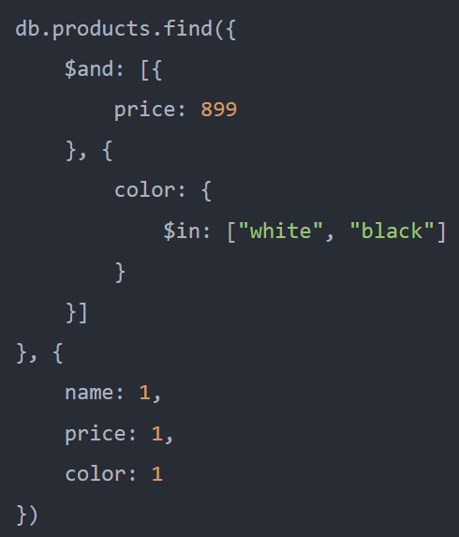
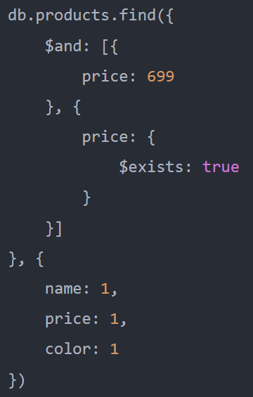
MongoDB $and operator - Examples

Slide 4
MongoDB $or operator
The $or is a logical query operator that carries a logical OR operation on an array of one or more expressions and selects the documents that satisfy at least one expression.
Here is the syntax of the $or operator

Slide 5
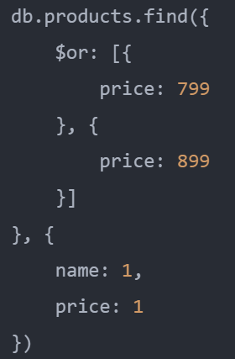
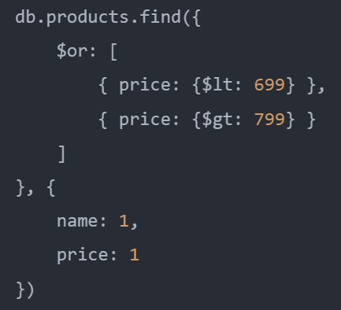
MongoDB $or operator - Examples

Slide 6
MongoDB $not operator
The $not operator is a logical query operator that performs a logical NOT operation on a specified <expression> and selects documents that do not match the <expression>. This includes the documents that do not contain the field.

Slide 7
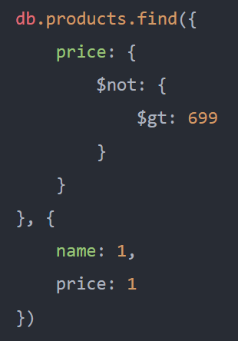
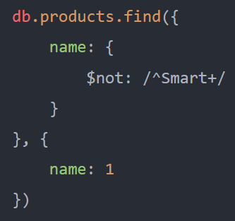
MongoDB $not operator - Examples

Slide 8
MongoDB $nor operator
The $nor is a logical query operator that allows you to perform a logical NOR operation on a list of one or more query expressions and selects documents that fail all the query expressions.

Slide 9
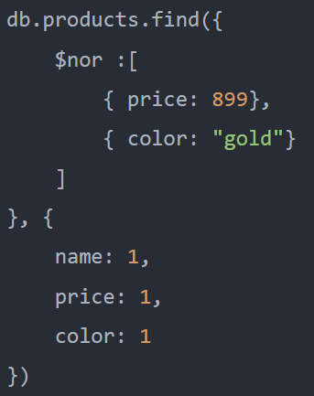
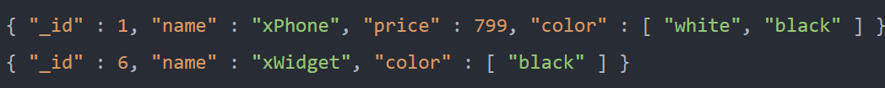
MongoDB $nor operator - Examples
It returns documents where:
the value is the price field is not 899
and the color array does not have any "gold" element.

Slide 10
Selecting Documents Using Element Query Operators

Slide 11
MongoDB $exists operator
The $exists is an element query operator that has the following syntax
When the <boolean_value> is true, the $exists operator matches the documents that contain the field with any value including null.
If the <boolean_value> is false, the $exists operator matches the documents that don’t contain the field.
The MongoDB $exists doesn’t correspond to the EXISTS operator in SQL

Slide 12
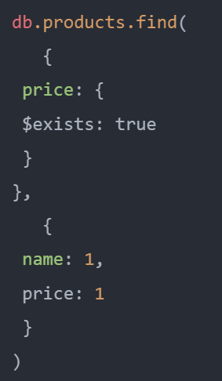
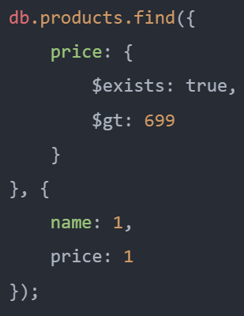
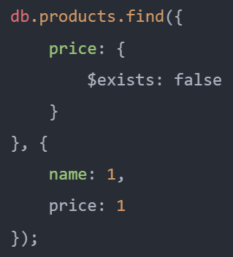
MongoDB $exists operator - Example

Slide 13

MongoDB $type operator
Sometimes, you need to deal with highly unstructured data where data types are unpredictable. In this case, you need to use the $type operator.
The $type is an element query operator that allows you to select documents where the value of a field is an instance of a specified BSON type.
The $type operator has the following syntax
The $type operator also accepts a list of BSON types like this
In this syntax, the $type operator selects the documents where the type of the field matches any BSON type on the list

Slide 14
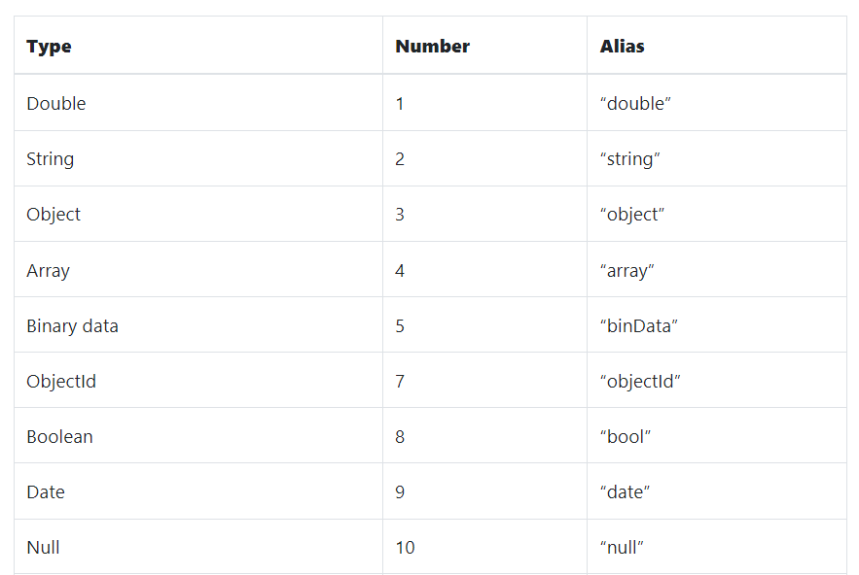
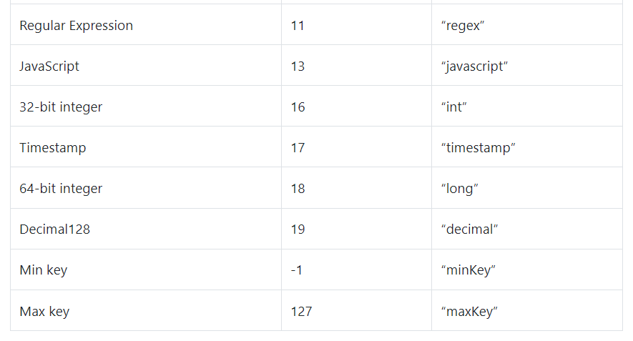
MongoDB $type operator
MongoDB provides you with three ways to identify a BSON type: string, number, and alias.

Slide 15
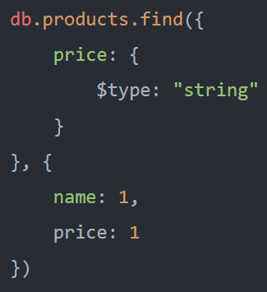
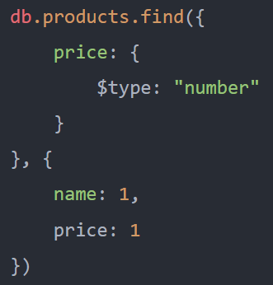
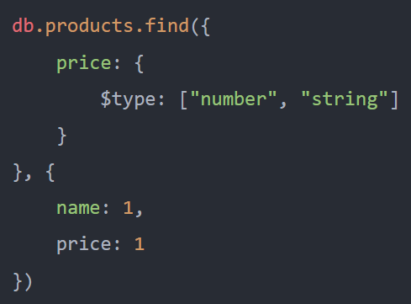
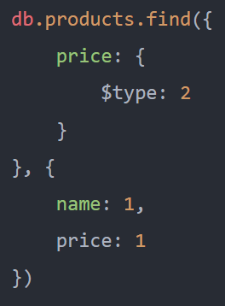
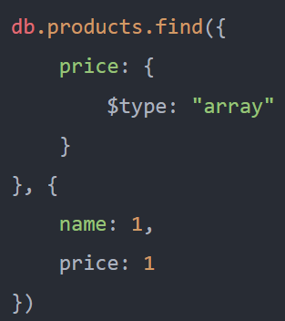
MongoDB $type operator - Examples

